Slide 1




Astronomy 1010 chapter 5
Clayton State University
Slides for Astronomy textbook from OpenStax
https://openstax.org/books/astronomy/

Slide 2

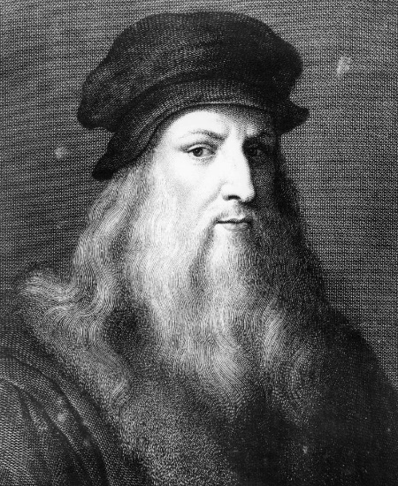
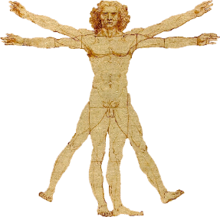
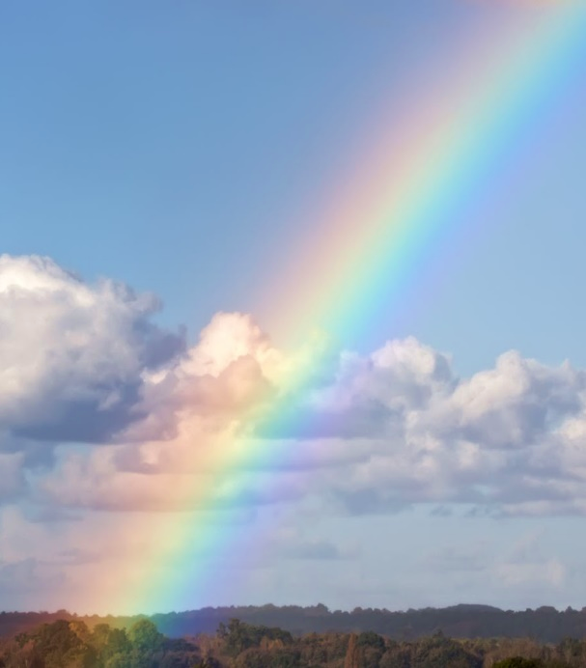
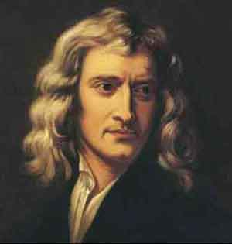
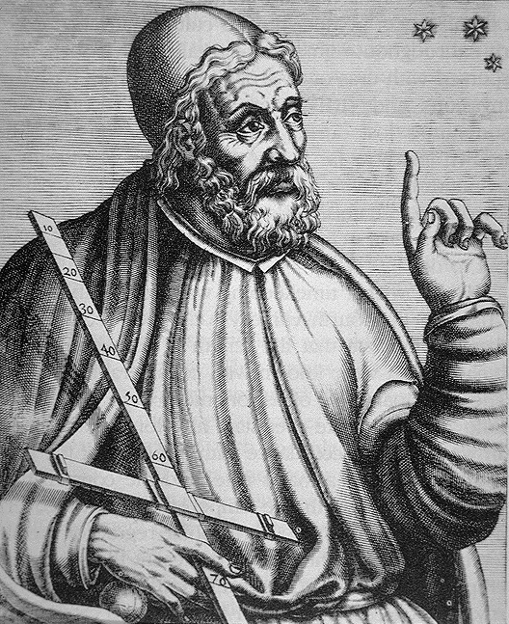
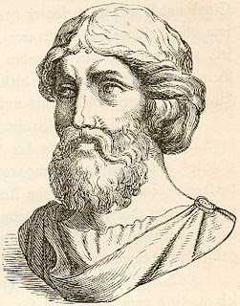

What is color in nature?
How many colors are there in the rainbow?
I chose colors this way
Newton: there are 7 colors
Ptolemy: there are 7 planets
Pythagoras: there are 7 music notes
Guru: there are 7 chakras

Slide 3
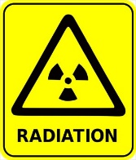
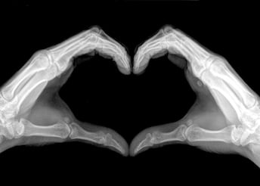



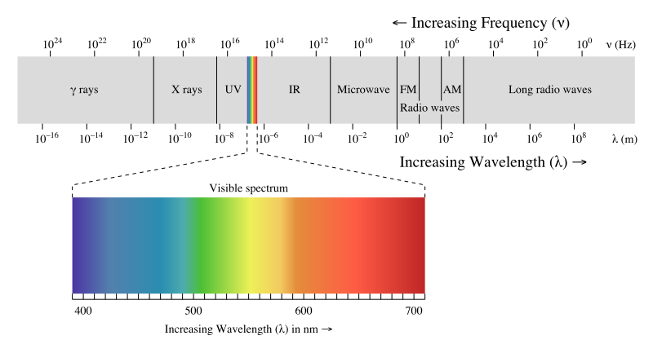

Light is an electromagnetic wave

Slide 4
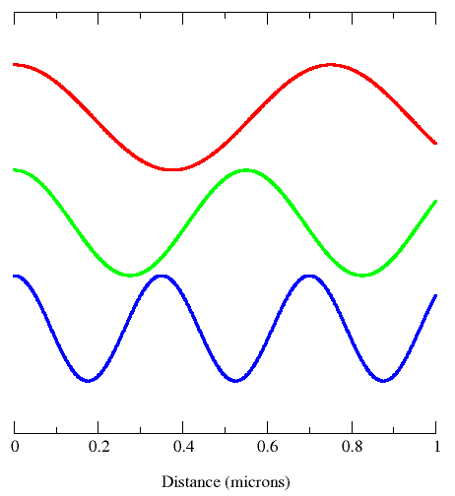
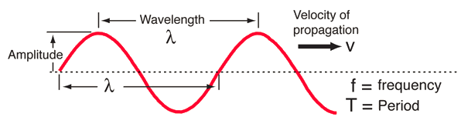
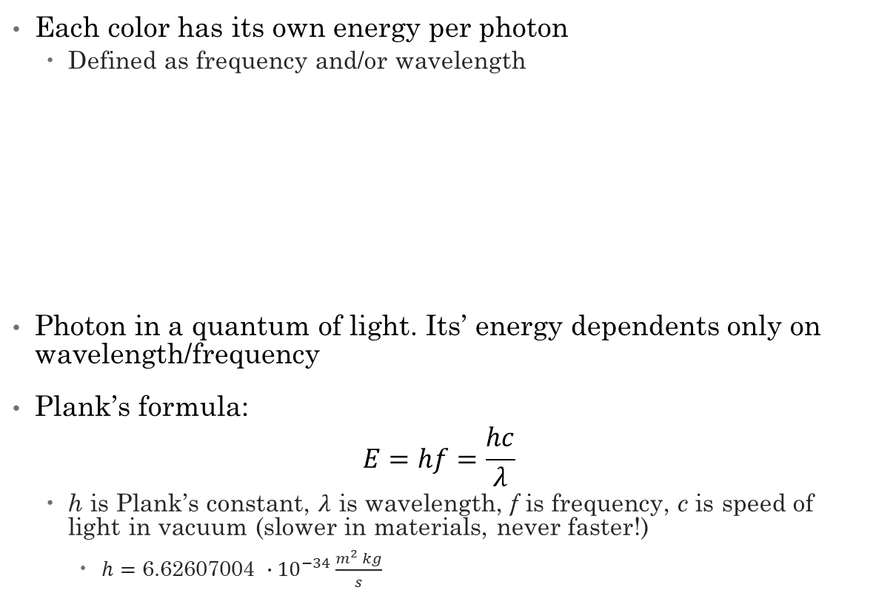
Colors in Nature
Each color has its own energy per photon
  Defined as frequency and/or wavelength
Photon in a quantum of light. Its’ energy dependents only on wavelength/frequency
Plank’s formula:
$$E=hf=\frac{hc}{λ}$$
  h is Plank’s constant, $λ$ is wavelength, f is frequency, c is speed of light in vacuum (slower in materials, never faster!)
    $h=\text{6.62607004 }∙{10}^{−34}\frac{m^{2} kg}{s}$

Slide 5
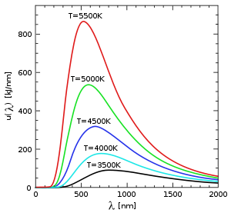
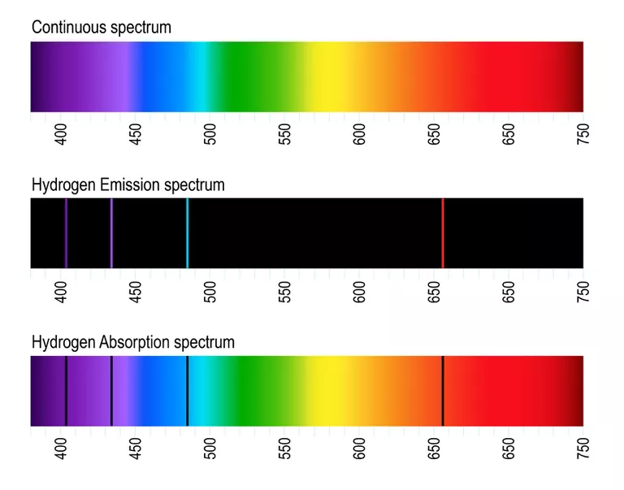
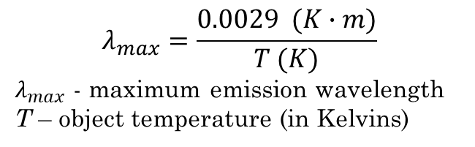
Types of Spectra
$$λ_{max}=\frac{0.0029 (K∙m)}{T (K)}$$
$λ_{max}$ - maximum emission wavelength
T – object temperature (in Kelvins)
Any heated solid or highly compressed gas gives continuous spectrum. Depends (mostly) on temperature alone (very weakly on composition).
Wien’s law is used to find the brightest color
Each element, when heated in rarified gaseous form, emits light at distinct colors – emission spectrum. Element’s passport.
If light passes though cold rarified gas, element absorbs exactly at same colors!

Slide 6
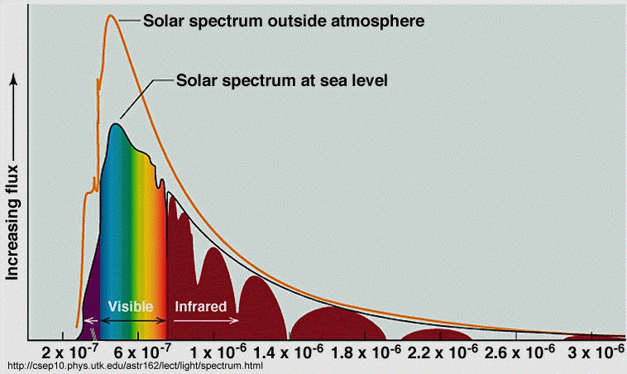
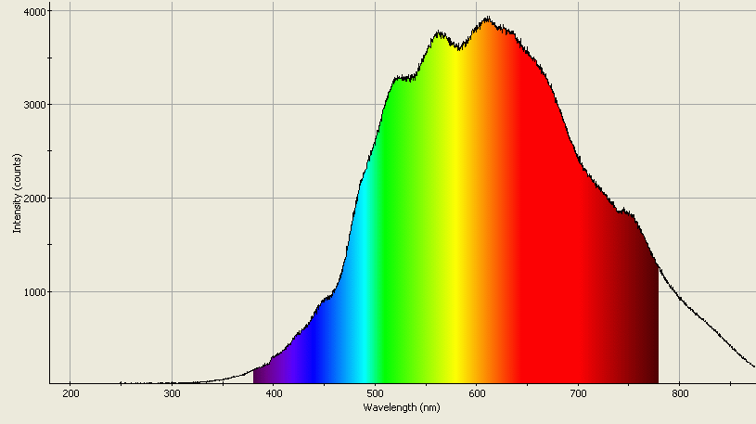
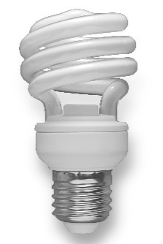
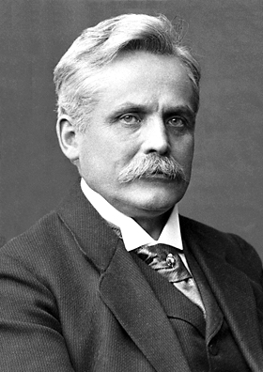
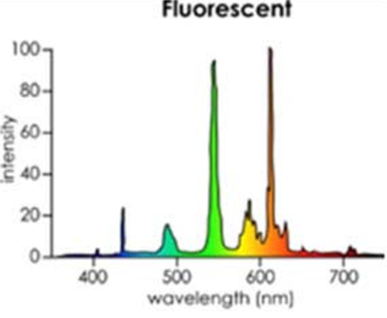
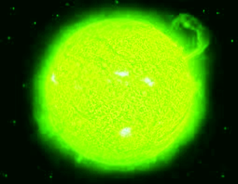
How many colors?
Sources like the Sun or incandescent (and LED?) lightbulbs give continuous spectrum.
Lasers give just one pure color as a rule.
You will see as many color shades as your eyes allow
  Can improve by training (https://www.ucreative.com/articles/9-games-for-graphic-designers/ )☺
Solar spectrum
Incandescent lightbulb spectrum
All is RGB, just trust me on that!
Fluorescent lights are commonly used in offices and at home. How come that we perceive them as while light?
The Sun is GREEN!?
Wilhelm Wien

Slide 7
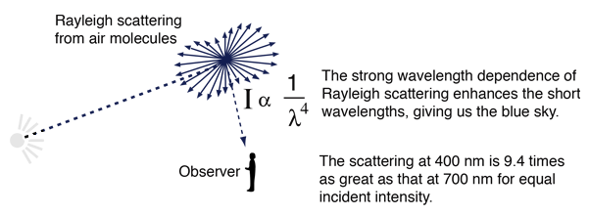
Scattering in atmosphere
Called Rayleigh scattering
Depends on frequency as f³ (or 1/λ⁴)
Sky looks blue, sun appears yellow mid-day and orange-reddish at sunset!
But this is NOT what gives us rainbow!

Slide 8
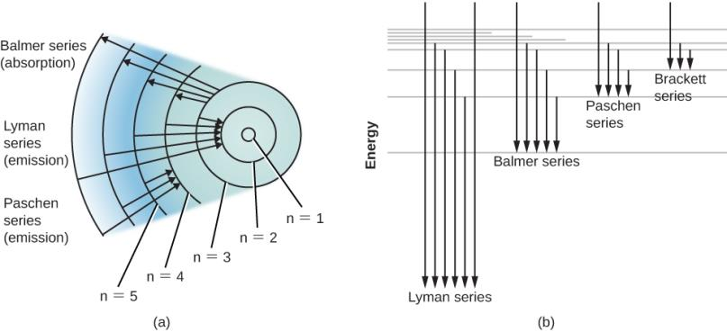



Formation of Emission spectra
Figure 5.20 (adapted)
$$n=3$$
$$n=2$$
$$n=1$$
Energy-Level Diagrams for Hydrogen.
(a) Bohr model. Different series of spectral lines are shown, corresponding to transitions of electrons from or to certain allowed orbits. Each series of lines that terminates on a specific inner orbit is named for the physicist who studied it. For Balmer series, arrows show electrons jumping from the second orbit (n = 2) to the third, fourth, fifth, and sixth orbits. Each time a “poor” electron from a lower level wants to rise to a higher position in atom, it must absorb energy to do so. It can absorb the energy it needs from passing waves (or photons) of light. The next set of arrows (Lyman series) show electrons falling down to the first orbit from different (higher) levels. Each time a “rich” electron goes downward toward the nucleus, it emits extra energy – corresponding to the transition.
(b) The region above the top line represents energies at which the atom is ionized (the electron is no longer attached to the atom). Each series of arrows represents electrons falling from higher levels to lower ones, releasing photons of specific energy in the process.

Slide 9
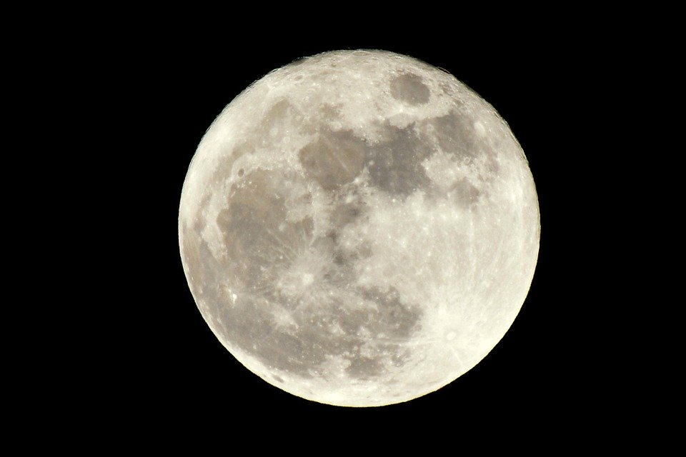

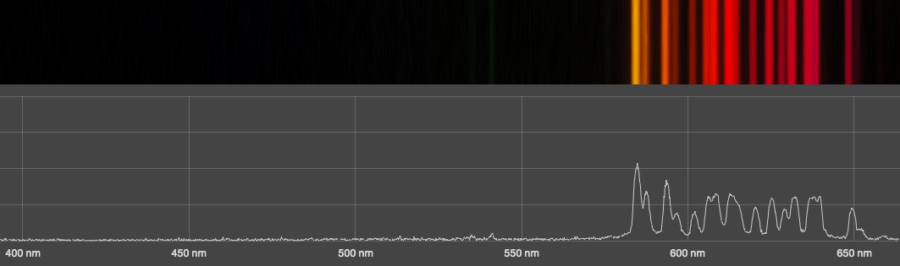
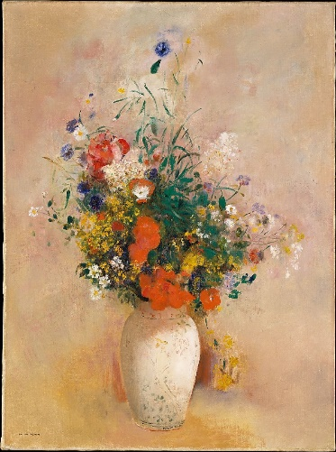
Self-check
Do these objects give continuous spectrum: why or why not?
          The Moon
          Neon lights
          Painting
            (on a computer screen)
Yes – the Moon only reflects sunlight
No – Neon is a gas: distinct spectral lines
No – we will discuss this later.

Slide 10
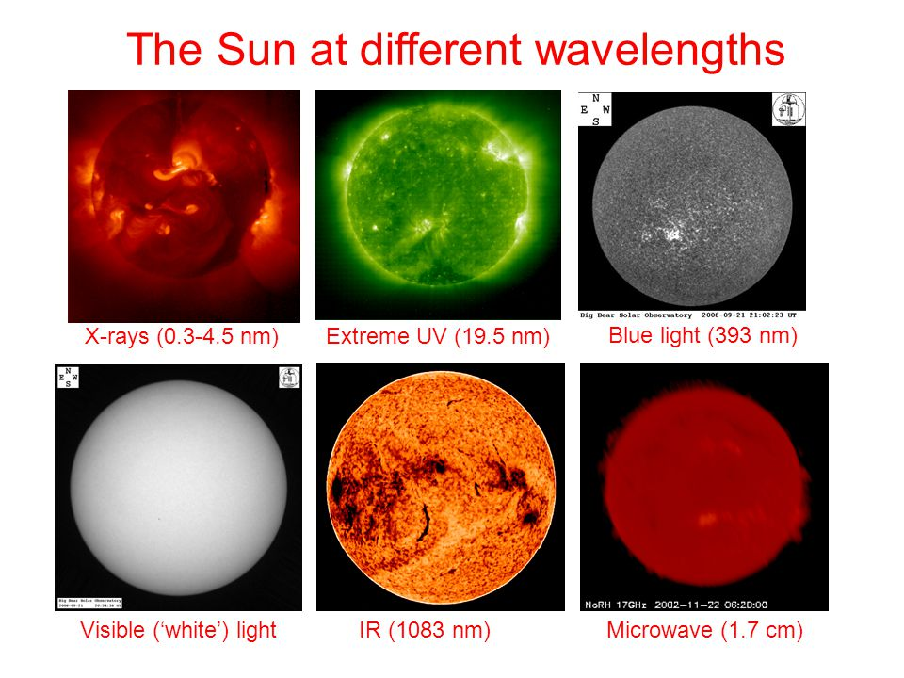
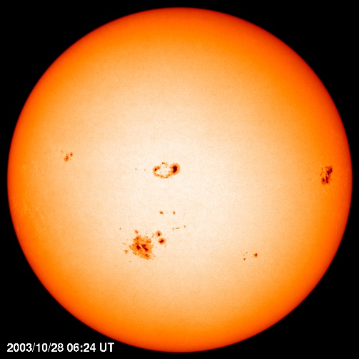
Sun in different wavelengths

Slide 11
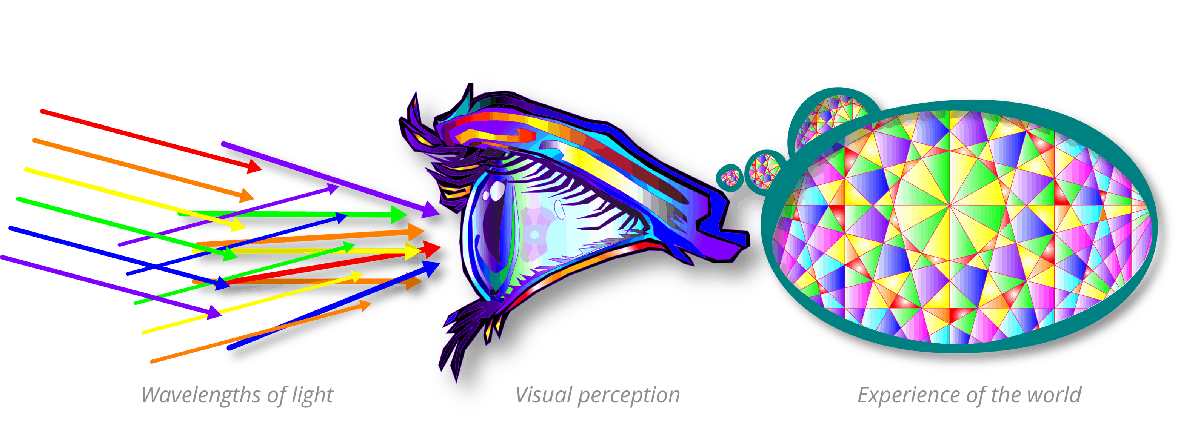
Visual perception
Visual perception is the ability to perceive our surroundings through the light that enters our eyes.
Eye focuses light on the retina.
Retina has a layer of photoreceptor (light-receiving) cells that convert light into a series of electrochemical signals.
Electrochemical signals are transmitted to the brain for processing

Slide 12
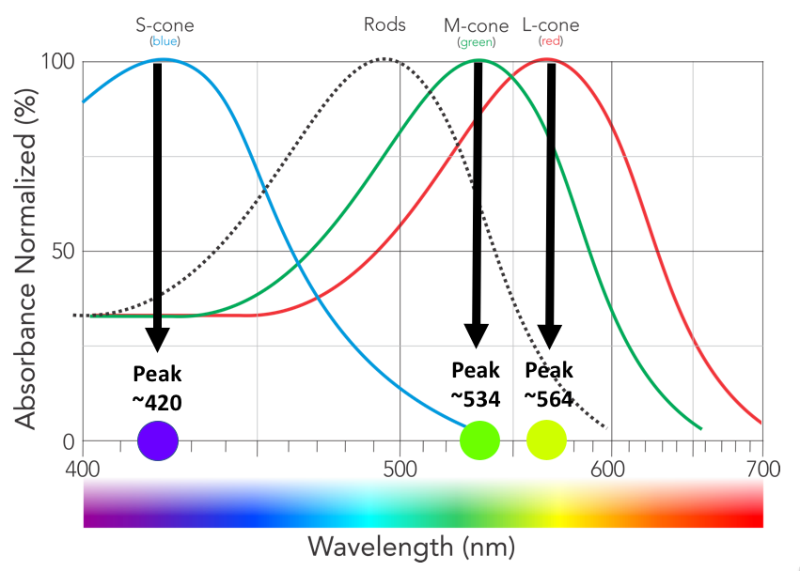
Color sensitivity of human’s eye

Slide 13

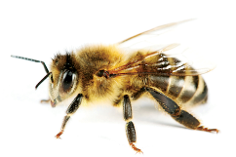

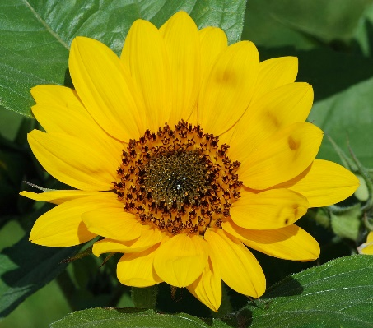


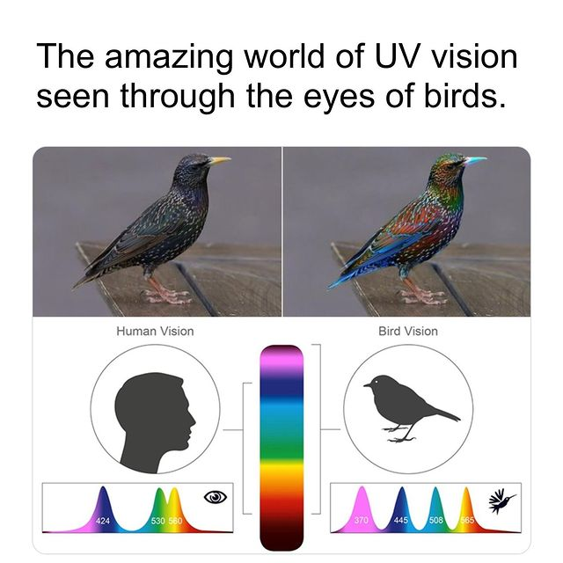
Flower, painting and monitor
Our eyes have receptors to see only THREE colors
  Red, Green, Blue, or RGB
Other colors are perceived as mix of these three
Computer screen uses only RGB!
Remember paint mixing? https://youtu.be/L1CK9bE3H_s?t=20
Fun facts: birds can see 11 colors and bees don’t see red but see low ultraviolet

Slide 14
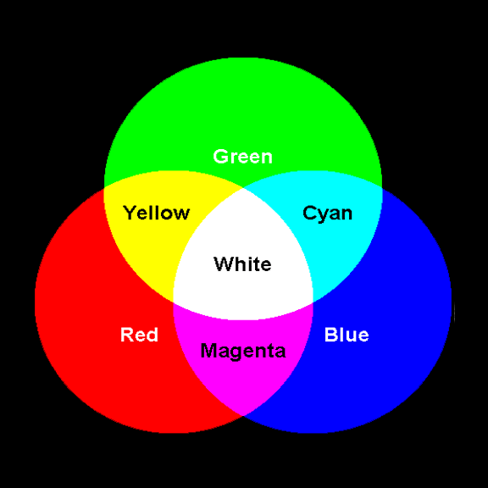
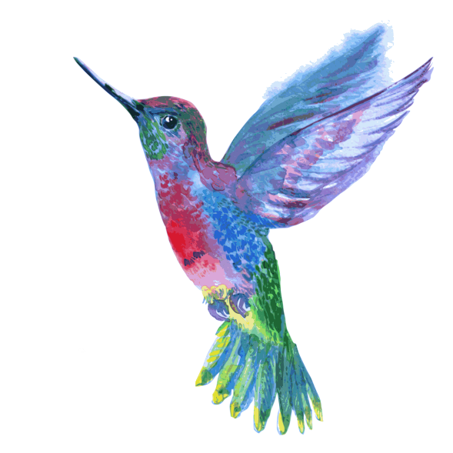
RGB recap
Computer screen uses additive color model. Paint mixing uses subtractive color model.
Need only 3 colors to fool human eye into seeing all colors
Birds, reptiles and insects will not appreciate our art or computer screens!

Slide 15
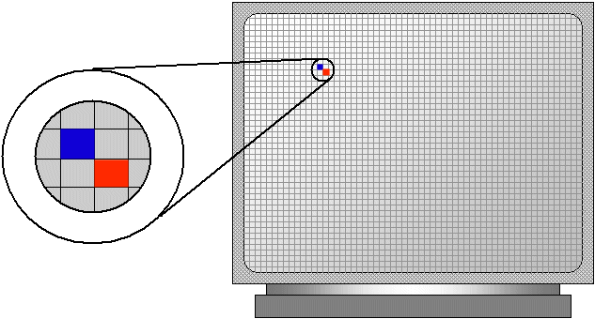
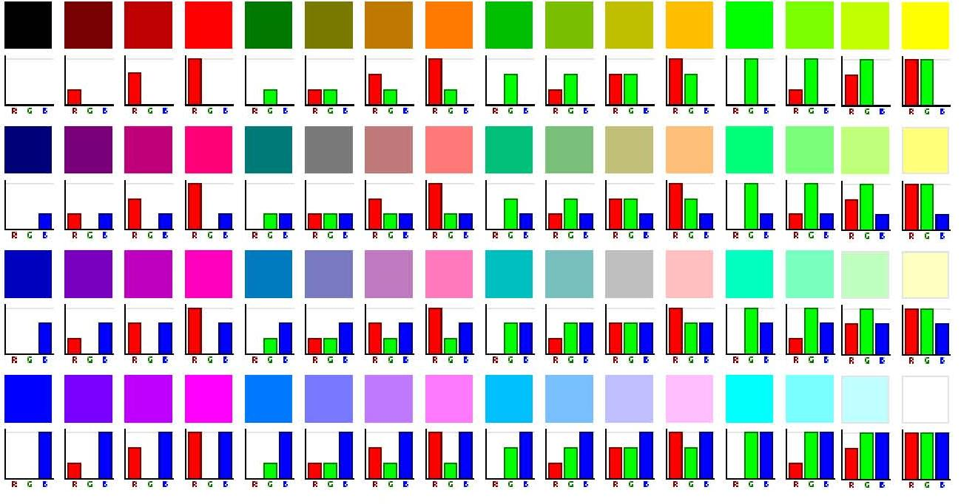
Computer Monitor and RGB
Computer screen is made of pixels
Each has RGB components
Combinations of three intensities can make up any color and brightness
0
255
0
255
0
255

Slide 16

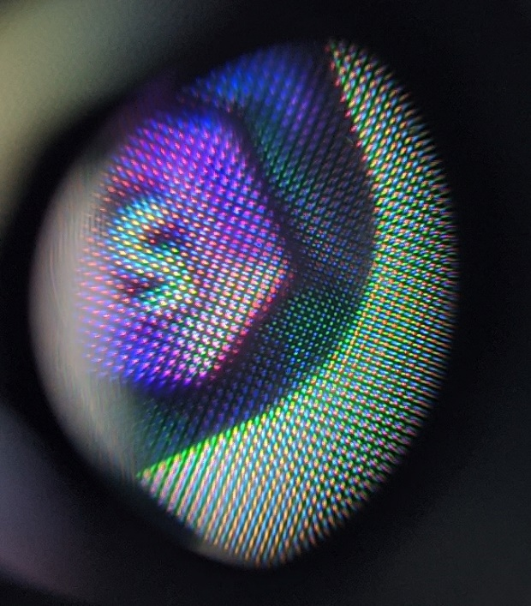
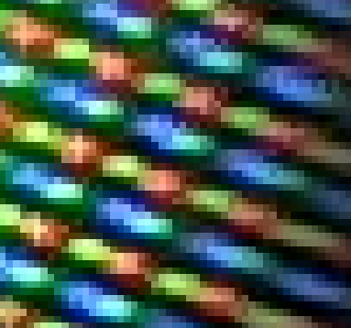

Any Questions?

